Slide 1
Predicting All-NBA Selection
Luxman Maheswaran
Duke University
Dept. of Statistical Science

Slide 2

All-NBA Introduction
All-NBA Selection
15 Players
1st, 2nd , 3rd Team
Importance
Legacy
Money
Decided by 100 experts
Recent Rule Changes
2023-2024 Onwards
Notes:
All-nba selection chooses the top 15 players to award at the end of the regular season. The best 5 go into the first then, the next 5 into the 2nd, and then the 3rd team. The reason it award is important is because it impacts a player’s legacy or their reputation. NBA Clipart from: https://freebiesupply.com/logos/nba-logo/

Slide 3
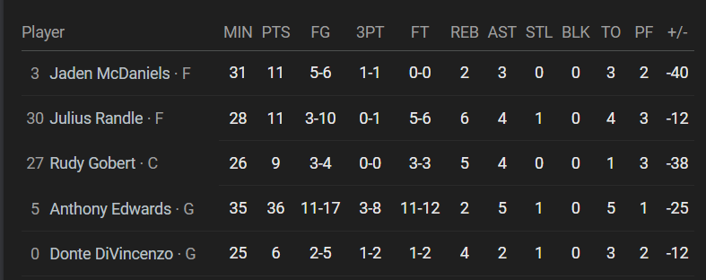
Data
Basketball Reference
2 Complete Seasons
Goal
Predicting All-NBA Selections w/ Advanced Metrics
Google UI Box Scores: Timberwolves vs. Clippers 3/11/2026

Slide 4
Advanced Metrics
Win Share
Individual Player’s Contribution
Box-plus-minus (BPM)
Point difference on/off court
Value-over-replacement-player (VORP)
Difference from theoretical replacement

Slide 5
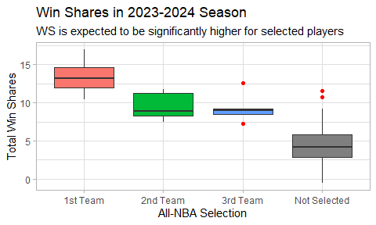

Slide 6
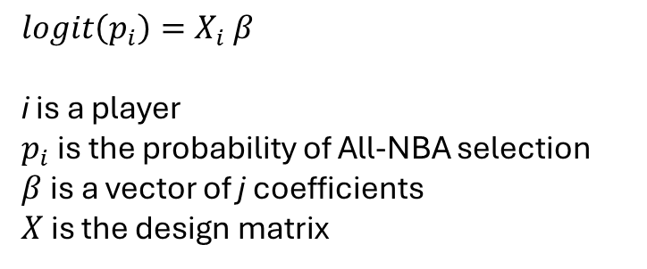
Modelling
Binary Outcome
Bayesian Logistic Regression
Small sample size
Sparse signal
14 Predictors
Avoid Complete Identification
Win Share
G, MP
FG, FGA, FT, FTA, PTS
TRB, AST, STL
TO, PF
$$logit\left(p_{i}\right)=X_{i} β$$
i is a player $p_{i}$is the probability of All-NBA selection
$β$is a vector of j coefficients
$X$ is the design matrix

Slide 7
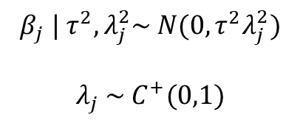
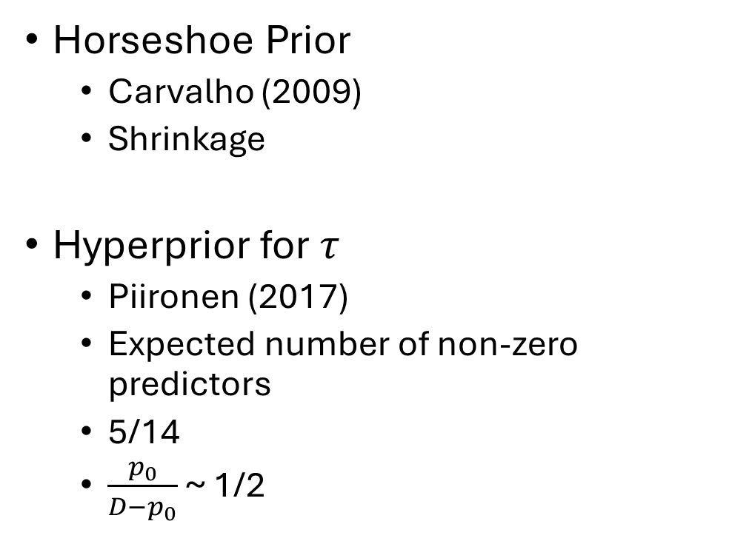

Prior Selection
Horseshoe Prior
Carvalho (2009)
Shrinkage
Hyperprior for $τ$
Piironen (2017)
Expected number of non-zero predictors
5/14
$\frac{p_{0}}{D−p_{0}}$ ~ 1/2
$$β_{j} | τ^{2}, λ_{j}^{2}\sim N(0, τ^{2}λ_{j}^{2})$$
$$λ_{j} \sim C^{+}(0,1)$$
$$τ \sim C^{+}(0,τ_{0})$$

Slide 8
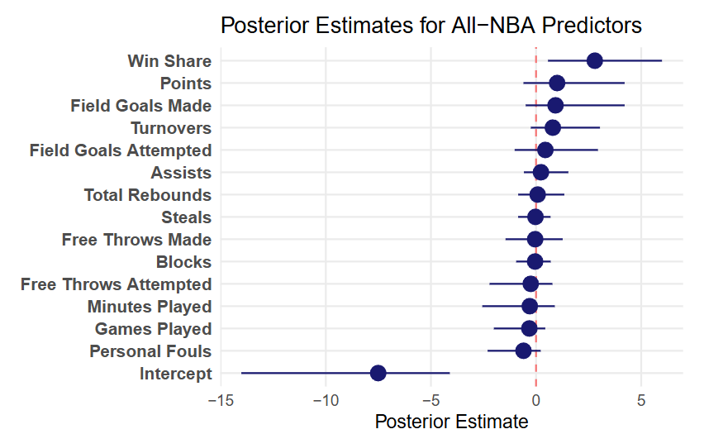

Slide 9
Discussion
Diagnostics
Similar Coef. For BPM, VORP
Validation on 2024-2025 Season
80% (12/15) correct
Good Order of All-NBA Teams

Slide 10
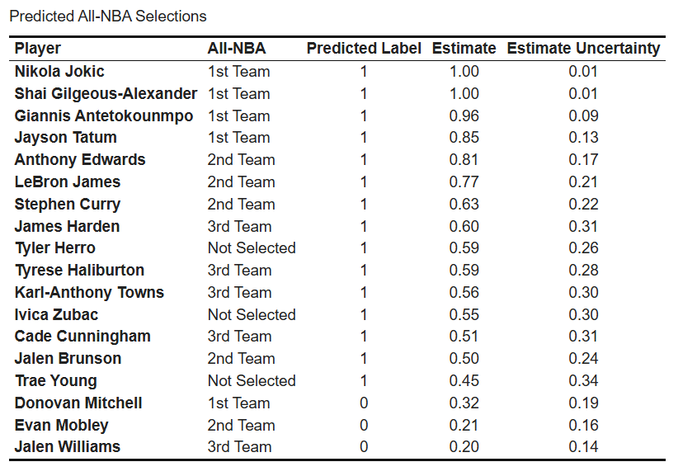

Slide 11
Limitations
Small Dataset
Scraping Limits
Position Constraints
Ignores Time Series Correlation
Past season performance
Limited scope of box score

Slide 12
Future Directions
Historical All-NBA Prediction
Player Rankings
Choice of Predictors/Model Design
Betting Odds
Evolving probabilities

Slide 13
References
Sports Reference LLC "2024-25 NBA Player Stats: Totals" Basketball-Reference.com - Basketball Statistics and History. https://www.basketball-reference.com/. Data pulled on: Feb. 03, 2026.2.
Bresler A (2026). nbastatR: R's interface to NBA data. R package version 0.1.153, commit f1e25e746f8a9dffdd7cc4eb3666efb37fc6a8b9, https://github.com/abresler/nbastatR.
Carvalho, C.M., Polson, N.G. & Scott, J.G.. (2009). Handling Sparsity via the Horseshoe. Proceedings of the Twelfth International Conference on Artificial Intelligence and Statistics, in Proceedings of Machine Learning Research 5:73-80 Available from https://proceedings.mlr.press/v5/carvalho09a.html.5.
Piironen, J., & Vehtari, A. (2017, April). On the hyperprior choice for the global shrinkage parameter in the horseshoe prior. In Artificial intelligence and statistics (pp. 905-913). PMLR.6.
Google. (2026). Gemini (3 Thinking/Flash version) [Large language model]. https://gemini.google.com/7.
OpenAI. (2026). ChatGPT (5.4 Thinking version) [Large language model]. https://chat.openai.com/chat

Slide 14
AI Disclosure
AI was used to create/edit/debug code, generate modelling ideas, and compare/contrast different ideas.

Slide 15
Thanks for Listening
Questions?

